Slide 1
Embeddings
Alberto TONDA, Ph.D. (Senior permanent researcher, DR)
UMR 518 MIA-PS, INRAE, AgroParisTech, Université Paris-Saclay UAR 3611, Institut des Systèmes Complexes de Paris Île-de-France

Slide 2
Outline
Embeddings
Building embeddings
Embeddings from trained deep networks
Embeddings with Autoencoders
Embeddings of Vocabularies

Slide 3
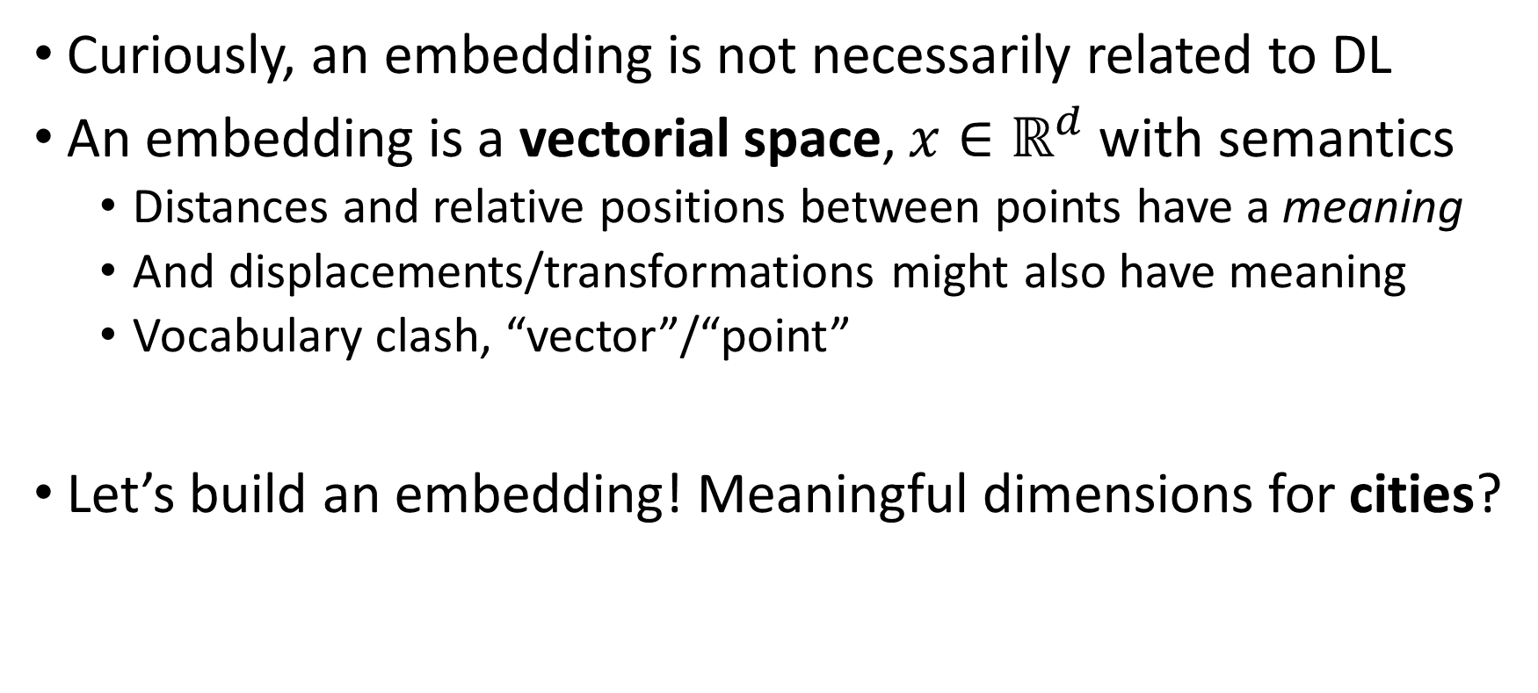
Embeddings
Curiously, an embedding is not necessarily related to DL
An embedding is a vectorial space, ${x∈ℝ}^{d}$ with semantics
Distances and relative positions between points have a meaning
And displacements/transformations might also have meaning
Vocabulary clash, “vector”/“point”
Let’s build an embedding! Meaningful dimensions for cities?
Notes:
Maybe different cities?

Slide 4
Embedding for cities
Milan
Frankfurt
Paris
London
Capracotta (pop: 799)

Slide 5
Building embeddings
Building embeddings is pretty hard
Already when we have meaningful features
But for relational data? Pixels, words, videos, sound, …?
Supervised task in DL architecture might create embedding
Output of a (deep) module can be interpreted as vectorial space
Encoding meaning related to supervised task
Notes:
Qui citazione di Caparezza

Slide 6

Embeddings from trained deep networks
More or less here
What would this encode?

Slide 7
Embeddings from trained deep networks
Taking VGG-16, output of deep modules
Might encode samples of same class close together
If we are lucky, samples of visually similar classes close together
However, encoded meaning related to visual aspects, only
Photo of bear and tiger very different, both ferocious predators

Slide 8
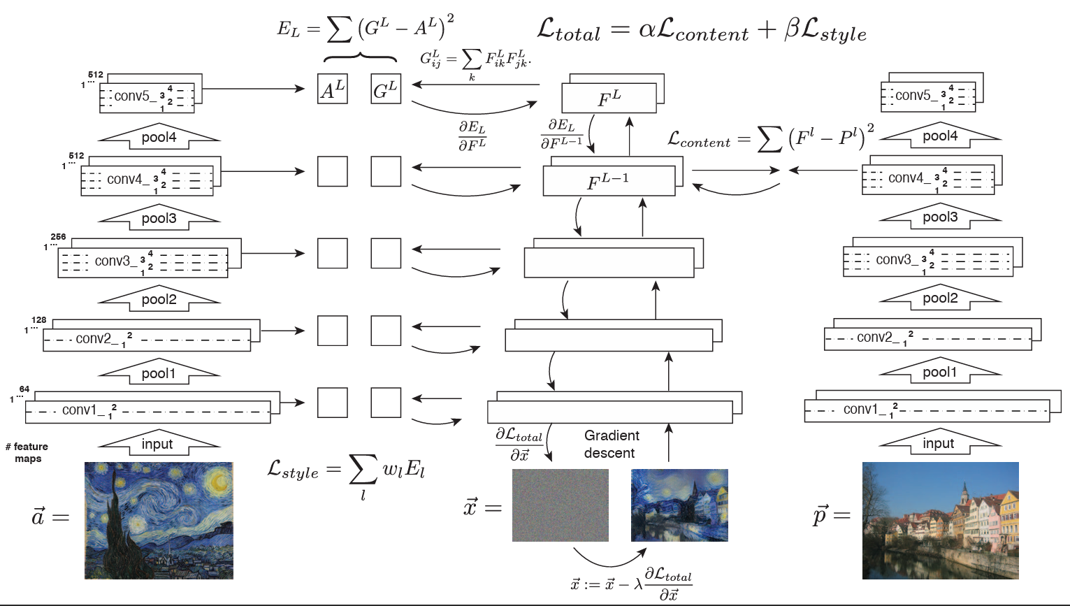
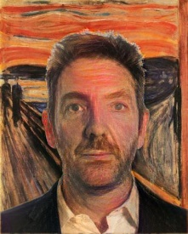


Embeddings from trained deep networks

Slide 9
Embeddings from trained deep networks
Minimize difference in position inside the embeddings

Slide 10
Embeddings, no tasks?
What if do not have a task, or a ground truth?

Slide 11
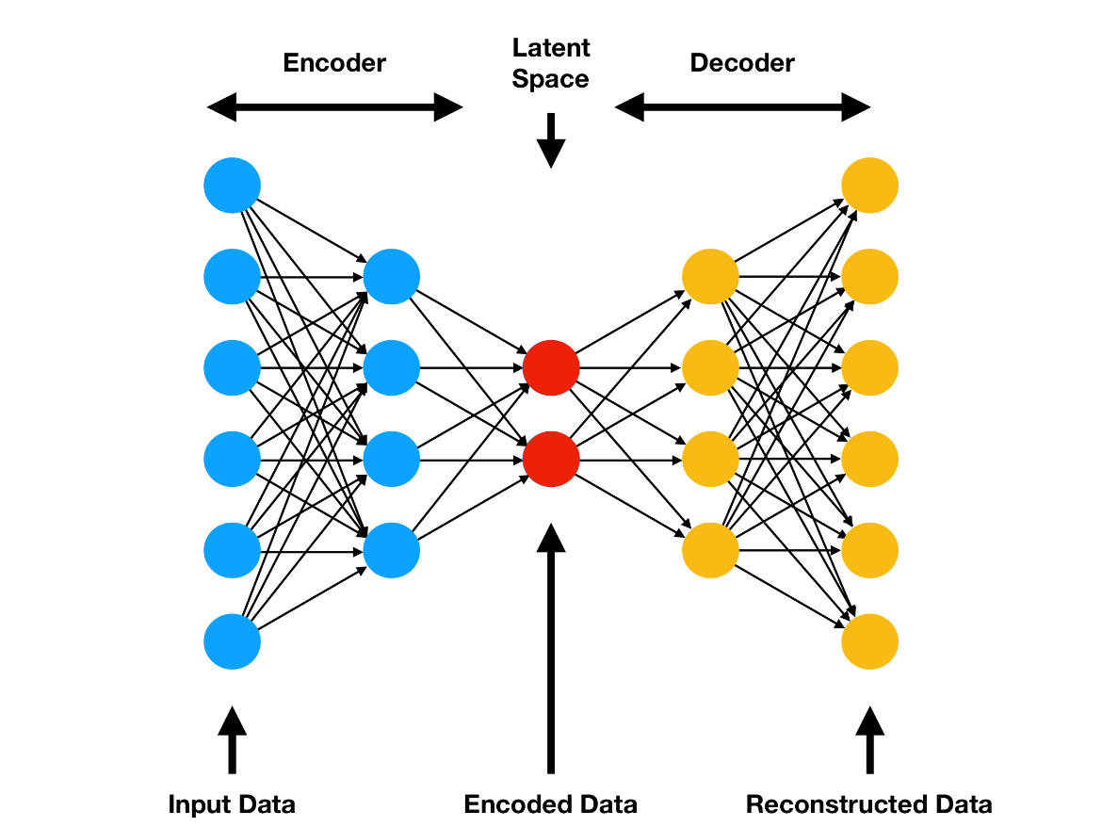
Embeddings with Autoencoders
Deep learning architecture
Series of modules with less and less output dimensions
A bit like the “funnel” in CNNs
Module in the middle, lowest dimension
Second part, “funnel out”
Back to the original dimension of input
Loss function: difference input-output
What does it mean?

Slide 12
Embeddings with Autoencoders
Deep learning architecture
Series of modules with less and less output dimensions
A bit like the “funnel” in CNNs
Module in the middle, lowest dimension
Second part, “funnel out”
Back to the original dimension of input
Loss function: difference input-output
Dimensionality reduction
Meaningful, to be able to reconstruct

Slide 13
Embeddings with Autoencoders
I
M
A
G
E
I
M
A
G
E
…
…
…
…

Slide 14
Embeddings with Autoencoders
Upsampling
I
M
A
G
E
I
M
A
G
E
…
…
…
…

Slide 15
Embeddings with Autoencoders
I
M
A
G
E
Random tensor of same size of the module output
…
…

Slide 16

Embeddings with Autoencoders

Slide 17
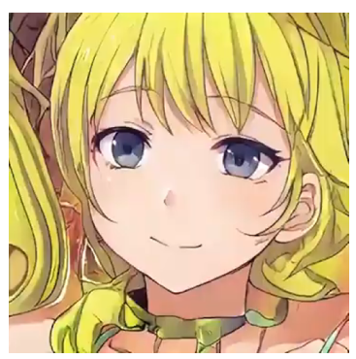
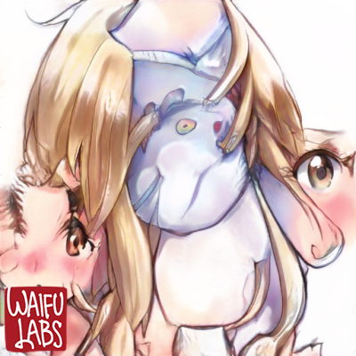
Embeddings with Autoencoders
Two different points (vectors) in the same embedding…

Slide 18
Embeddings of Vocabularies
Vocabulary
Set of finite size, discrete elements (element: “token”)
Classic example: words, characters, bitstrings
But also, e.g. possible chessboard configurations in chess
Words, in particular, are difficult to manipulate for AI
Map to symbols, but not 1:1
“Chicken” vs “chicken”! “Mole” vs “mole” vs “mole”! Context?!?
Discrete: an integer per word? Not really expressive…

Slide 19
Vocabulary embedding: Word2Vec
Revolutionary idea
Arbitrary number of dimensions for the embedding
(n_vocabulary, n_embedding)
Simple neural network architecture
Input: one-hot encoding of a vocabulary
Output/Loss: task connected to meaning
Use learned weights as word embedding

Slide 20
Vocabulary embedding: Word2Vec
“Mary”
0.2
-1.9
LINEAR
MODULE
(Vocabulary size *
Embedding size)
weights, no bias
-0.1
Embedding size
0
…
1
1.4
We don’t have a task! How do we know if this representation is meaningful?
Vocabulary size
?
0
…
0
One-hot encoding

Slide 21
Vocabulary embedding: Word2Vec
We already have lots of organized relational data
Text! Words are not randomly organized: sentences, paragraphs
Use text to generate meaningful training samples
Classic unsupervised learning tricks
Slide a window on the text
For example, predict the next word
“Mary had a little lamb”
(Mary, had), (had, a), (a, little), (little, lamb)

Slide 22
Vocabulary embedding: Word2Vec
0.2
Predict the next word!
“had”
“Mary”
-1.9
LINEAR
MODULE
(Vocabulary size *
Embedding size)
weights, no bias
LINEAR
MODULE
(Embedding size *
Vocabulary size)
weights, no bias
Softmax
-0.1
Embedding size
0
…
0.0
1
1.4
…
Vocabulary size
Vocabulary size
0
0.1
…
0.9
0
0.2
One-hot encoding
Backpropagating categorical cross-entropy loss

Slide 23
Vocabulary embeddings: Word2Vec
Continuous Bag of Words (CBoW)
Predict the word between two other words
“Mary had a little lamb”
(Mary, had), (a, had); (had, a), (little, a); (a, little), (lamb, little)

Slide 24
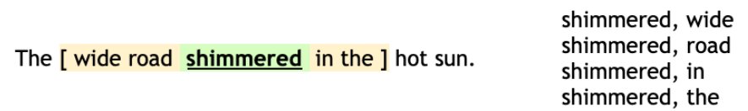
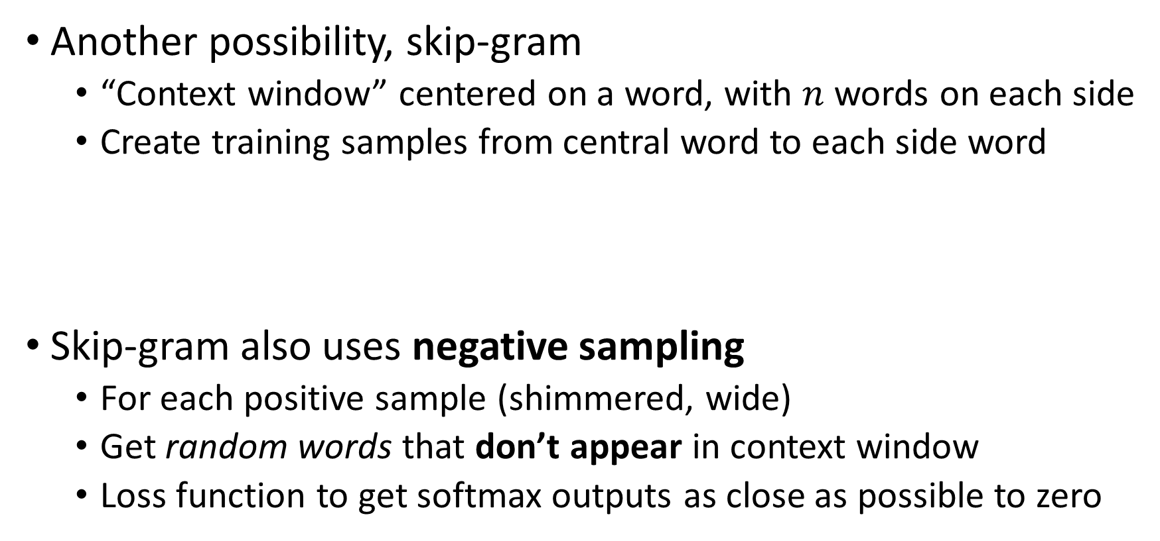
Vocabulary embeddings: Word2Vec
Another possibility, skip-gram
“Context window” centered on a word, with $n$ words on each side
Create training samples from central word to each side word
Skip-gram also uses negative sampling
For each positive sample (shimmered, wide)
Get random words that don’t appear in context window
Loss function to get softmax outputs as close as possible to zero

Slide 25
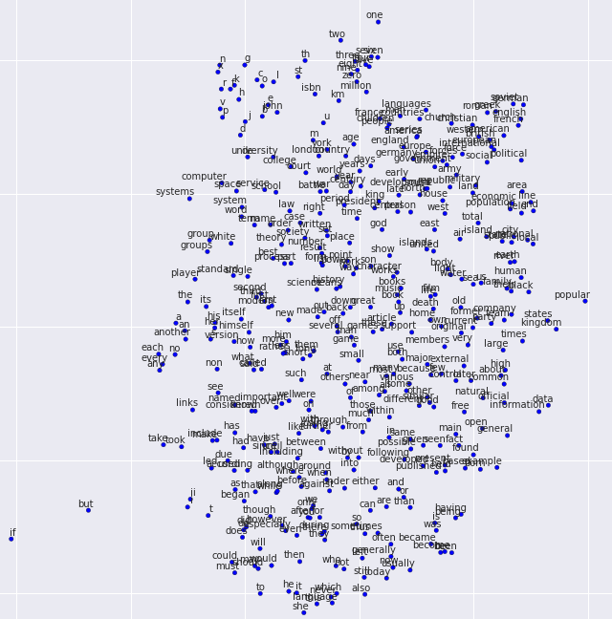
Word2Vec

Slide 26
Word2Vec

Slide 27
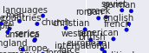
Word2Vec
“French”, “British”, “American”…
Adjectives for nationality!
Nearby, you have “languages”, “countries”
Also, “England”, “Europe”, “International”, …

Slide 28
Word2Vec

Slide 29
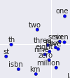
Word2Vec
“one”, “two”, “zero”, “seven”, “million”…
Numbers, quantities; nearby, some units of measurement
Also “th”, and “st”, as in 9-th, 1-st
ISBN (guess usually appears nearby numbers!)

Slide 30
Word2Vec
What is happening here?
Algorithm has no semantic info (no meaning)
But words with similar meaning are close
Just by looking at the position of words in text
Similar use -> same positions with respect to other words
Word2Vec captures some aspects of meaning
Can we do something else with Word2Vec?

Slide 31
Word2Vec
“Woman”
WOMAN - MAN
TRANSFORMATION THAT CAN BE COMPUTED
“Man”

Slide 32
Word2Vec
“Queen”
“Woman”
WOMAN – MAN + KING = QUEEN
“King”
MASCULINE -> FEMININE
“Man”

Slide 33
Word2Vec
Let’s think about this for a second
No meaning inserted into the algorithm
Words with similar meaning cluster together
Mathematical transformations provide meaningful results
DOG : PUPPY = CAT : ???
PUPPY - DOG
“Puppy”
“Kitten”
“Dog”
“Cat”

Slide 34
Word2Vec
What does all this mean?
We are not really sure
Obtain semantics just from word positions
Maybe semantics is not as hard of a problem as it looks
And Word2Vec is an incredibly simple architecture!
More complex architectures might get even better
And they are (ChatGPT, Transformers, etc.)

Slide 35
Creating a Vocabulary
Creating a Vocabulary is not straightforward
Elements in Vocabulary are called “tokens”
“Tokenization” is the process to create good tokens
It’s another optimization problem
“What is the set of tokens that gives me the best result?”
E.g., discard or keep less frequent tokens?

Slide 36
Creating a Vocabulary
Example: text from natural language?

Slide 37
Creating a Vocabulary
Example: text from natural language?
Seems pretty intuitive, 1 word = 1 token; but nuances
Special tokens, <SOS> (Start of Sequence) and <EOS> (End)
Actually more efficient to use parts of a word
“Cod” might be better than “Code”: “Cod-es”, “Cod-ing”, “En-cod-ing”
Kind like mapping to word roots, even if not exactly
What happens if input is “Grzegorz Brzęczyszczykiewicz”?

Slide 38
Creating a Vocabulary
In practice, solved by declaring character-level tokens
Tokenization attempts on largest possible matching tokens
If it fails, fall back on smaller and smaller tokens
Test GPT-4 tokenization, platform.openai.com/tokenizer

Slide 39
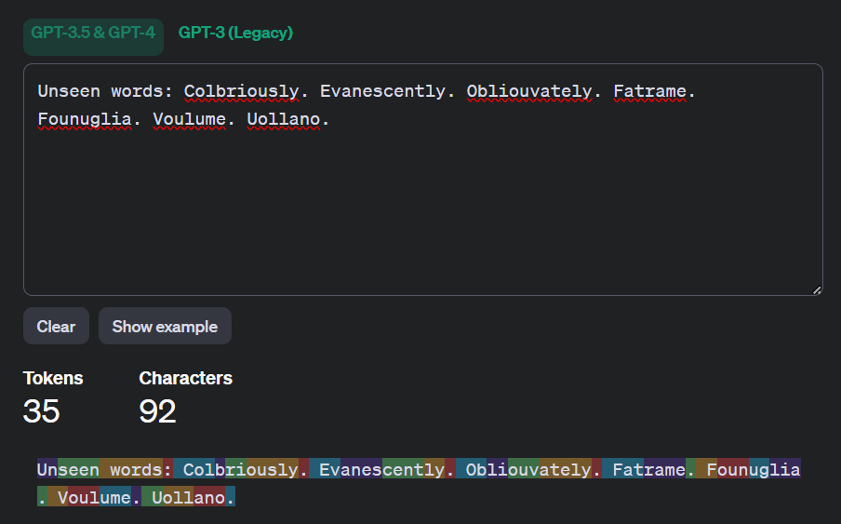
Creating a Vocabulary

Slide 40
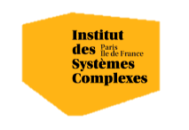

Questions?
Bibliography - Mikolov, T., Chen, K., Corrado, G., & Dean, J. (2013). Efficient estimation of word representations in vector space. arXiv preprint arXiv:1301.3781.
Images and videos: unless otherwise stated, I stole them from the Internet. I hope they are not copyrighted, or that their use falls under the Fair Use clause, and if not, I am sorry. Please don’t sue me.

